Slide 1
Archery

Slide 2
History of Archery
The discovery of the first arrowheads date back to pre 25,000 B.C. according to Carbon dating. The first known arrowheads were located in Africa and were made from fire-hardened flint.

Slide 3
History Continued..
The earliest bows that have been discovered were found in Denmark and date somewhere around 8,000-6,000 B.C. These bows were one piece bows, and usually comprised of yew or elm. These bows would bend evenly from top to bottom. (Elm bow →)

Slide 4
Introduction to Archery
https://www.youtube.com/watch?v=BEG-ly9tQGk
FUN FACTS:
After Civil War ended, many people were denied access to firearms so they relied on the bow to live off the land
Archery became an Olympic sport again in 1972

Slide 5
The Recurve Bow
The bow we will be using during class is called a “Recurve Bow”. This bow requires the user to string the bow before it’s used, and also breakdown the string after use.

Slide 6
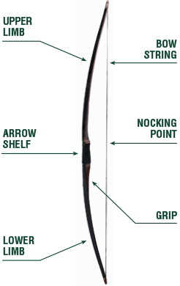
Bow & Arrow
Anatomy of

Slide 7
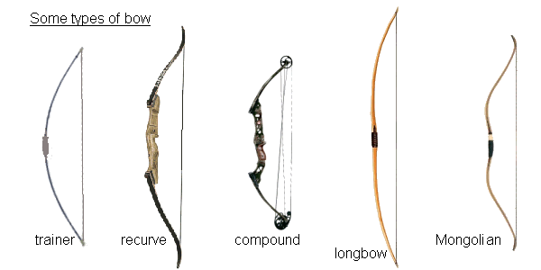
Equipment
Bows can be made from wood or fiberglass
Types of bows: recurve and compound
Arrows made from: wood, fiberglass, aluminum, or carbon graphite
Fletching (vanes) – made from waterfowl feathers, hard and soft plastics
Strings – woven strands of waxed linen, Dacron andDevlar strands

Slide 8
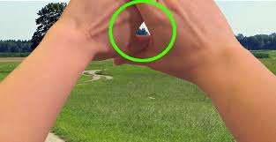
Finding your dominant eye
With both eyes open, look through the triangle and center something such as a doorknob in the triangle. Close your left eye. If the object remains in view, you are right eye dominant. If closing your right eye keeps the object in view, you are left eye dominant

Slide 9
Archery Safety, Scoring and Skill Cues for Shooting
https://www.youtube.com/watch?v=AorB3wCe2Rc

Slide 10
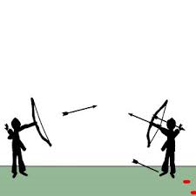
Top Priority: Safety
Students must straddle the line while shooting.
No one can retrieve arrows until I give the cue to do so. Entire line of shooters will have shot all three arrows. (3 whistles-retrieve arrows)
Students must give bow to partner when retrieving arrows.
Partner will stand behind shooters at a safe distance (draw elbow).
Left handed shooters must shoot to targets aligned to the left of the range, right handed shooters must shoot to targets aligned to the right (back to back).
When walking with arrows, make sure the head is pointed to ground.
If there is a safety rule broken, you will not shoot another arrow for the rest of the semester….I guarantee it!!

Slide 11
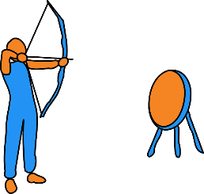
11 Steps to Successful Shooting
STANCE- Straddle the line, feet square. Dominant eye/arm away from target
NOCK- Click in your arrow. 90º
SET DRAW HAND- “Claw” the string with middle three fingers. 1st knuckle.
SET BOW HAND- Place your hand in the bow grip.
PRE-DRAW- Rotate bow arm elbow down and under.
DRAW- Pull or draw the string.
ANCHOR- Draw arm above and parallel to floor. Touch index finger to corner of your mouth.
AIM- String, arrow point, riser alignment.
SHOT SET-UP- Slight separation from draw shoulder and hand, slowly initiating the release.
RELEASE- Move draw arm rearward while simultaneously relaxing fingers/back of hand.
FOLLOW- Through the release. Finish position, reflect on shot.

Slide 12
Range Protocol
One student per group holding bow. Arrows laid in front of shooters feet.
Key words: Nock, Aim, Fire
Odd color fletch away from bow
Students MUST stay behind FIRING LINE until the retrieve arrows indicator is given: 3 WHISTLES
Hand bow to partner while retrieving arrows
Keep arrows pointed at the ground unless aiming/firing

Slide 13
Archery Scoring System
We will use this scoring system in class
The two Inside Gold's are worth 10-9
The Reds are worth 8-7
Blue is worth 5-6
Black is 3-4
White is worth 1-2
If a shot misses the target completely, a score of 0 is recorded.
*If a shot is on or touching the lines of the circle, the next highest circle is the point value that is received.*

