Slide 2
Setting Goals
LESSON ONE
LESSON ONE
Turn to page 6 in your student manual. As you watch the video, record your responses to each question.
Page 5

Slide 3
Take a moment to record responses to the discussion questions on page 6.
Goal Setting
LESSON ONE
What is a goal?
Why are goals important?
What can keep you from reaching your goals?
Page 6

Slide 4
What is a Goal?
LESSON ONE
As you discuss the questions after each story, write down the answers in your student manual.
Erik Weihenmeyer
What did Erik desire in the future?
What barriers did Erik encounter?
How did Erik overcome the barriers in reaching his goal?
Oprah Winfrey
What did Oprah desire in the future?
What barriers did Oprah encounter?
How did Oprah overcome her barriers in reaching her goal?
Page 7

Slide 5
How to Set a Goal/Personal Goal Setting
LESSON ONE
Please refer to page 8 in your student manual. As you discuss how to set a goal and personal goals, please fill in your student manual.
Page 8

Slide 6
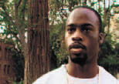
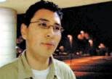
Avoiding Detours
LESSON ONE
What can keep you from reaching your goals?
Amy
How could sexual activity become a detour in your life and prevent you from reaching your goals?
What is the only way to avoid detours resulting from sexual activity?
Kevin
Daniel
Page 9

Slide 7
Determination
LESSON ONE
Please refer to page 10 in your student manual. As you discuss the questions, write the answers in your book. Be prepared to complete the homework assignment and parent/guardian interviews as assigned.
Page 10

Slide 8
Making the BEST Decisions
LESSON TWO
LESSON TWO
Turn to page 12 in your student manual. As you watch the video, record your responses to each question.
Page 11

Slide 9
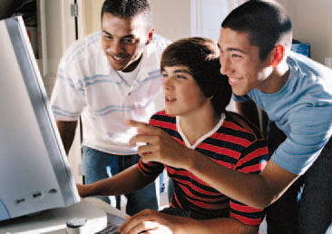
Take a moment to record responses to the discussion questions on page 12.
Sex and Alcohol Don’t Mix
LESSON TWO
LESSON TWO
1. What advice did these young people give on making decisions?
2. How can friends and peers influence your decision making?
3. What factors contribute to bad decisions?
Page 12

Slide 10
Barriers to Making Good Decisions
LESSON TWO
LESSON TWO
A
cting before thinking…the tendency to act on an impulse before ________________about potential consequences.
ccepting other’s decisions in order to fit in…the tendency to let others make ___________________for you.
lcohol/drugs…the inability to make good decisions while under the ____________________.
thinking
A
decisions
A
influence
Please refer to page 13 in your student manual to read about Nicole’s decisions.
Page 13

Slide 11
How Alcohol Affects Teenagers
LESSON TWO
LESSON TWO
Fill in the blanks with the correct answers.
Alcohol acts as a depressant on the central nervous system to lower normal healthy inhibitions, leading to increased at-risk behavior.
seven
Death
Alcohol
50%-75%
sexual
2. Alcohol changes how the brain functions and can be harmful to teenage growth and development.
School
Death
3. People who begin drinking alcohol can impair brain function and lead to unconsciousness and even _______.
four
Page 14

Slide 12
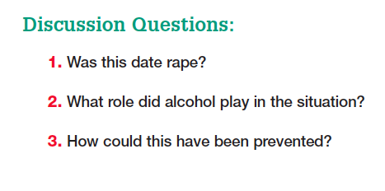
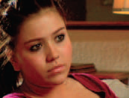
What Do You Know About Date Rape?
LESSON TWO
LESSON TWO
Refer to page 15 in your student manual and complete the True/False section on date rape.
1. True
2. False
3. True
4. True
5. True
6. False
7. True
8. True
9. False
10. False
Page 15

Slide 13
Sex and Respect
LESSON TWO
Please refer to page 16 and 17 in your student manual for instructions on making a decision chart
Pages 16 and 17

Slide 14
Sex and Respect
LESSON TWO
Please refer to page 18 in your student manual. As you discuss the questions, write the answers in your book. Be prepared to complete the homework assignment and parent/guardian interviews as assigned.
Page 18

Slide 15
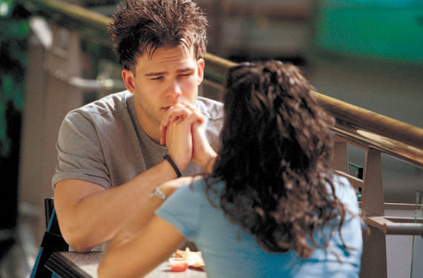
Avoiding Pregnancy
LESSON THREE
Turn to page 20 in your student manual. As you watch the video, record your responses to each question.
Page 19

Slide 16
Take a moment to record responses to the discussion questions on page 20.
Avoiding Teen Pregnancy
LESSON THREE
Why did these young people think that getting pregnant couldn’t happen to them?
In what ways did a pregnancy change their lives?
How did the pregnancy affect their relationships?
Page 18

Slide 17
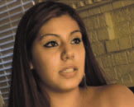
What If?
LESSON THREE
Read about Athena, Daniel and Amy on page 21 of your student manual. Record your answers to the following questions.
What could Athena’s life have looked like at age 30
if she had waited until marriage to have sex and not
become pregnant?
What could Daniel’s life have looked like at age 30
if he had waited until marriage to have sex?
What could Amy’s life have looked like at age 30 if
she had waited until marriage to have sex, and not
become pregnant?
Page 21

Slide 18
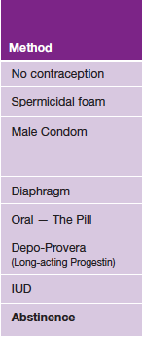
Reducing the Risk
LESSON THREE
Please refer to the contraceptive chart on page 22 in your student manual.
Page 22

Slide 19
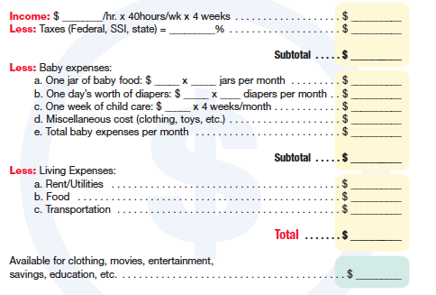
A Budget for Baby
LESSON THREE
Turn to page 23 in your student manual to work on “A Budget for Baby.” Record the amounts in the chart provided.
$7300
$50,000
Page 23

Slide 20
Responsibility
LESSON THREE
Please refer to page 24 in your student manual. As you discuss the questions, write the answers in your book. Be prepared to complete the homework assignment and parent/guardian interviews as assigned.
Page 24

Slide 21
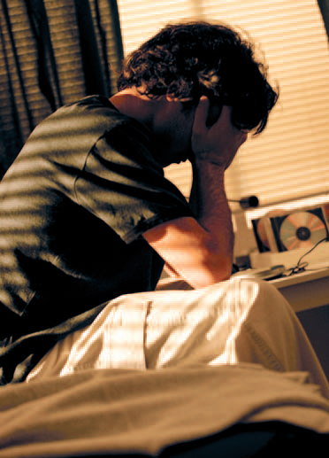
Avoiding STDs
LESSON FOUR
Turn to page 26 in your student manual. As you watch the video, record your responses to each question.
Page 25

Slide 22
Avoiding the Risk of STDs
LESSON FOUR
LESSON ONE
Take a moment to record responses to the discussion questions on page 26.
How did contracting an STD affect the lives of these young people?
Why are most teenagers not concerned about contracting an STD?
Why are young people especially vulnerable to contracting an STD?
Page 26

Slide 23
STDs
LESSON FOUR
Fill in the blanks with the correct answers.
Word Bank
25
One
Many
4 million
multiple
65 million
STD
every
No
15 million
cervix
Page 27

Slide 24
STDs
LESSON FOUR
Fill in the blanks with the correct answers on page 28 of your student manual.
Chlamydia
3 million
1.5 million
no
3 to 5
infertile
oral
Gonorrhea
650,000
no
oral
PID
Trichomoniasis
5 million
no
cured
Page 28

Slide 25
STDs
LESSON FOUR
Fill in the blanks with the correct answers on page 29 of your student manual.
HPV
5.5 million
50%
Cancer
HPV
Die
no
Oral
vaccine
Genital Herpes
1 million
45 million
90%
Life
Blisters
sexual
HIV/AIDS
1 million
sexual
Page 29

Slide 26
Facts vs. Myths About HIV/AIDs
LESSON FOUR
Fill in the blanks with the correct answers on page 30 of your student manual.
Myth #1
Myth #2
Myth #3
Myth #4
Myth #5
Sexual
Not; Many
Immune; Opportunistic
Not
34%
Page 30

Slide 27
What About “Safe Sex”?
LESSON FOUR
Condom
Consistently
Correctly
Not
Half
How well do condoms work for birth control?
Break
15
How well do condoms reduce the risk of contracting STDs?
85
15
Secretions
50
50
Skin
Skin
No
No
Abstinence
Page 31

Slide 28
Honesty
LESSON FOUR
Please refer to page 32 in your student manual. As you discuss the questions, write the answers in your book. Be prepared to complete the homework assignment and parent/guardian interviews as assigned.
Page 32

Slide 29
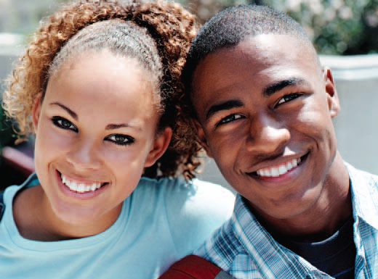
Developing the BEST Relationships
LESSON FIVE
Turn to page 34 in your student manual. As you watch the video, record your responses to each question.
Page 33

Slide 30
Developing the BEST Relationships
LESSON FIVE
Take a moment to record responses to the discussion questions on page 34.
What qualities were these young people looking for in relationships with the opposite sex?
For those who were sexually involved, how did sex affect their relationships?
What factors help a healthy relationship develop?
Page 34

Slide 31
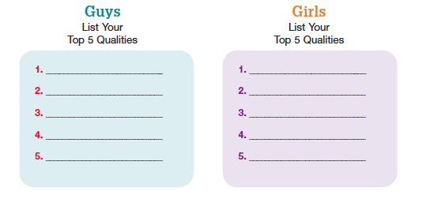
What are YOU Looking for?
LESSON FIVE
Please turn to page 35 in your student manual. As you participate in the activity about Guys and Girls, fill in your student manual.
Page 35

Slide 32
Avoiding Relational Traps
LESSON FIVE
disappointment
getting
give
possessive
love
feelings
quickly
time
love
physical
not
Page 36

Slide 33
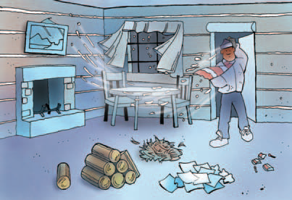
How to Develop the BEST Relationships
LESSON FIVE
Consider Yourself
Chemistry
Compatibility
Character
Commitment
Right
Attracted
Common
Real
Another
Page 37

Slide 34
I Am Unique, One-of-a-Kind
LESSON FIVE
Please refer to page 38 in your student manual to complete the activity.
Page 38

Slide 35
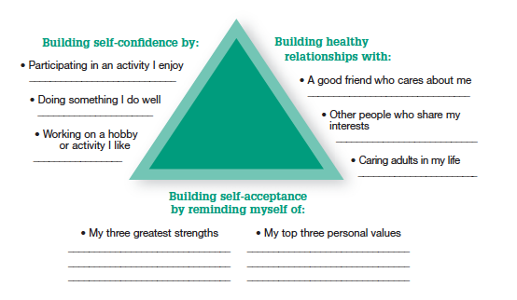
Building Self-Esteem
LESSON FIVE
Please refer to page 39 in your student manual to complete the activity.
Page 39

Slide 36
Self-Respect
LESSON FIVE
Please refer to page 40 in your student manual. As you discuss the questions, write the answers in your book. Be prepared to complete the homework assignment and parent/guardian interviews as assigned.
Page 40

Slide 37
Choosing Abstinence Until Marriage
LESSON SIX
Turn to page 42 in your student manual. As you watch the video, record your responses to each question.
Page 41

Slide 38
Choosing Abstinence
LESSON SIX
Take a moment to record responses to the discussion questions on page 42.
Why are these teenagers choosing to be abstinent?
Why did some of those who were sexually active choose to stop?
How does being abstinent affect a relationship?
Turn to page 33 in your student manual. As you watch the video, record your responses to each question.
Page 42

Slide 39
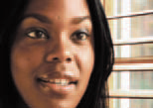
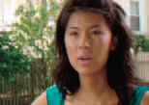
Potential Emotional Consequences
LESSON SIX
Which emotional consequence(s) is Robin experiencing?
Robin
Which emotional consequence(s) is Nick experiencing?
Nick
Which emotional consequence(s) is Sarah experiencing?
Sarah
Page 43

Slide 40
Choosing the Best Life
LESSON SIX
Take a moment to record answers on page 44.
Abstinence is making an informed decision _____to participate in at-risk sexual behavior which includes:
not
1. ________________________2._______________________
3. ________________________4._______________________
Abstinence provides Freedom
From:
To:
For Relationships:
Renewed Virginity – A Chance to Start Over
STATEMENT 1:
STATEMENT 2:
STATEMENT 3:
Accountable
Similar
Beginning
Page 44

Slide 41
Compatibility Areas
LESSON SIX
Please refer to page 45 in your student manual to complete the activity.
Page 45

Slide 42
Dating to Discover
LESSON SIX
Please refer to page 46 in your student manual and read “Dating to Discover”.
Page 46

Slide 43
Commitment
LESSON SIX
Refer to page 47 in your student manual. Record answers on the chart provided.
Infatuation
Love
Focus
Feelings
Time Together
Tested
Commitment
I
How_____feel
________ intense
Together a _______ time
No real ___________
To ______ well-being
other
How_______person feels
________ out over time
Together a ______ time
Worked _________ problems
To ______ person’s well-being
Very
Levels
short
long
problems
through
my
other
Refer to page 47 in your student manual to take the “Love Test”.
Page 47

Slide 44
Making Healthy Choices
LESSON SIX
Please refer to page 48 in your student manual. As you discuss the questions, write the answers in your book. Be prepared to complete the homework assignment and parent/guardian interviews as assigned.
Page 48

Slide 45
Overcoming the Pressure
LESSON SEVEN
Turn to page 50 in your student manual. As you watch the video, record your responses to each question.
Page 49

Slide 46
Overcoming the Pressure
LESSON SEVEN
Take a moment to record responses to the discussion questions on page 50.
What message does the media send young people about sex?
How does peer pressure contribute to being sexually active?
Why are setting boundaries important in a relationship?
Page 50

Slide 47
Media Pressure
LESSON SEVEN
Please refer to page 51 in your student manual. As you discuss the pressures of media, please fill in the “false” messages and the “fact” messages.
Page 51

Slide 48
Teen Magazine Pressure
LESSON SEVEN
Based upon the articles listed on this magazine cover, what is the main focus of this particular teen magazine?
 | 1. | Most teens do read a magazine on a typical day.
 | 2. | Most girls do not let the models they see in magazines influence their ideas of the perfect body.
 | 3. | About half of teenage girls say they have been on a diet over the past year.
 | 4. | The body type of models shown in ads represents the general population.
 | 5. | Most teens believe that teen girls often receive the message that attracting boys and looking sexy is on of the most important things they can do.
 | 6. | Girls with low self-esteem are more likely to be pressured into having sex.
T
F
T
F
T
T
Discussion Questions:
How much influence do you think magazines have over guys?
What kind of messages do teen magazines send about sex?
What messages do teen stars send about love, respect and relationships?
Page 52

Slide 49
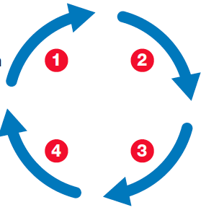
The Porn Problem
LESSON SEVEN
Please refer to page 53 in your student manual. As you discuss the “Porn Problem”, please fill in the answers
1. Curiosity
2. Don’t
3. More
4. Controls
• Boys: 9
• Girls: 13
• 11
• 90%
Page 53

Slide 50
Overcoming Pressure
LESSON SEVEN
Please refer to page 54 in your student manual. As you discuss strategies to overcome pressure, please fill in the answers.
Page 54

Slide 51
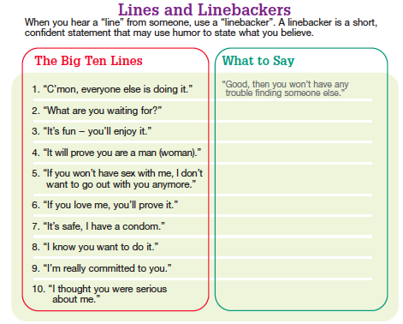
Overcoming Peer Pressure
LESSON SEVEN
Please refer to page 55 in your student manual. As you discuss strategies to overcome peer pressure, please fill in the answers.
Page 55

Slide 52
Self-Discipline
LESSON SEVEN
Please refer to page 56 in your student manual. As you discuss the questions, write the answers in your book. Be prepared to complete the homework assignment and parent/guardian interviews as assigned.
Page 56

Slide 53
Being Assertive
LESSON EIGHT
Turn to page 58 in your student manual. As you watch the video, record your responses to each question.
Page 57

Slide 54
Developing Refusal Skills
LESSON EIGHT
Take a moment to record responses to the discussion questions on page 58.
What kind of pressure did these teenagers feel?
What helped them overcome the pressure?
It is possible to tell someone “no” and still communicate that you care for him/her? How?
Page 58

Slide 55
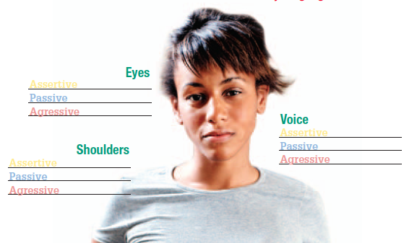
Becoming Pressure-Proof
LESSON EIGHT
Step Three: SHOW IT! – Being Assertive
Please refer to page 59 in your student manual. As you discuss becoming pressure proof, please fill in the chart provided.
Page 59

Slide 56
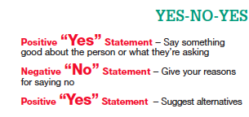
Learning How to Say NO With Positive Results
LESSON EIGHT
Please refer to page 60 in your student manual to learn about Yes-No-Yes and creative dating activities.
Page 60

Slide 57
Role-Play – “In the Heat of the Moment”
LESSON EIGHT
As you discuss the role-play, record responses to the discussion questions in your student manual.
How realistic was the role-play?
How did Alicia demonstrate her assertiveness?
Do you think Bryan got the message?
What are some other ways that Alicia could have avoided this pressure situation?
Page 61

Slide 58
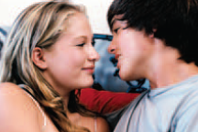
Role-Play – “Come On Over”
LESSON EIGHT
As you discuss the role-play, record responses to the discussion questions in your student manual.
How realistic was the role-play?
How did Andrew demonstrate his assertiveness?
Did Marissa get the message?
What are some other ways that Andrew could have avoided this pressure situation?
Page 62

Slide 59
Role-Play – “No Respect”
LESSON EIGHT
As you discuss the role-play, record responses to the discussion questions in your student manual.
How realistic was the role-play?
How did Andrea demonstrate her assertiveness?
Did Stefan get the message?
What are some other ways that Andrea could have avoided this pressure situation?
Page 63

Slide 60
Sex and Courage
LESSON EIGHT
Please refer to page 64 in your student manual. As you discuss the questions, write the answers in your book. Be prepared to complete the homework assignment and parent/guardian interviews as assigned.
Page 64

