Slide 1
Hillgrove High School Fishing
Rod/Reel Anatomy
Types of Reels
Tackle
Types of Line
Types of Rigs
Fishing Knots

Slide 5
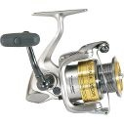
Spinning
This “open-face reel” mounts under the rod. Fishing line spools off quickly allowing longer casts. This reel is able to cast lighter baits and lures
Spincast
This popular reel is ideal for beginners. Known as a “closed-faced reel,” it’s the easiest reel to use.

Slide 6
Bait-cast
Bait-cast tackle is suitable for all types of fish and fishing. The spool turns when you cast, however, and can entangle the line if not properly adjusted. You’ll need to practice with this model.

Slide 7
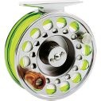
Fly reel The fly reel is designed to allow fluid movement of the fishing line. This reel is mounted on the bottom of the rod.

Slide 8
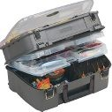
A tackle box allows you to safely organize and carry your
tackle to and from your fishing spot!

Slide 10
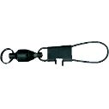
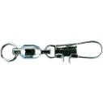
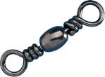
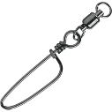
Swivels & Snaps
SNAP: Used to connect leader, hook or lure to line.
Makes it easy to quickly change lures, etc.
SWIVEL: Keeps line from twisting in water & allows
lures to spin freely.

Slide 11
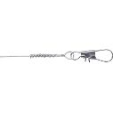
Leaders
The purpose of a leader is to add extra strength to the end of the fishing line. The fishing line can be damaged by rocks or by submerged tree trunks. This is usually where the fish are.

Slide 12
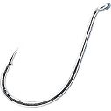
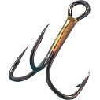
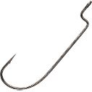
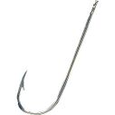
HOOKS
Sizes, designs, shapes, and materials are all variable depending on the type of fish you intend to catch and the type of fishing your are participating in.
The larger the hook size,
the smaller the hook!

Slide 13
CATFISH RIG

Slide 14
Bass Rigs

Slide 15
Brim Rig

Slide 16
Fishing Line
Three basic types of fishing lines monofilament, braided and fluorocarbon
Monofilament: plastic line, usually made of nylon. It is made by pouring melted plastic into a tube, which shapes the line.
Braided: consist of inter-wined strands of nylon material; allows for more strength
Fluorocarbon: does not absorb water; will not stretch out or weaken

Slide 17
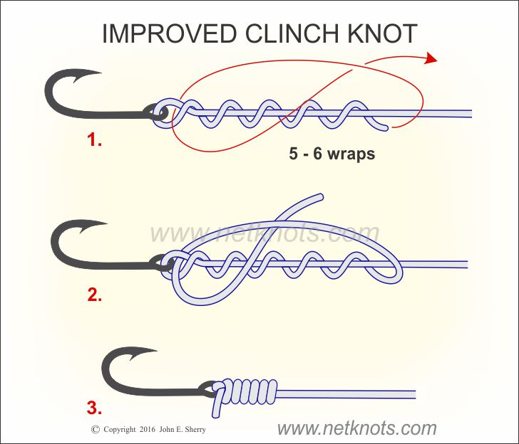
Improved Clinch Knot
Commonly used to fasten the leader to the fly
Not recommended if you are using over 30 lb test line.
Advantages: It is particularly suited for attaching a small diameter tippet to a heavy wire hook. The extra final tuck improves your chances of holding a strong fish.
https://www.animatedknots.com/improvedclinch/index.php

Slide 18
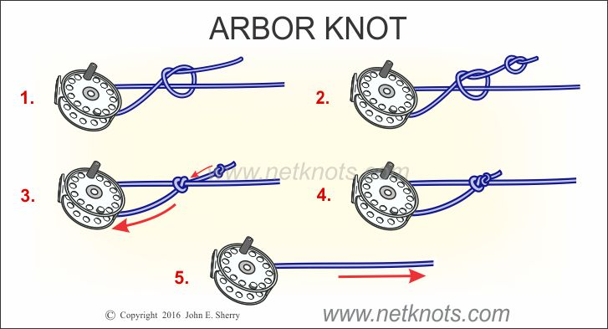
Arbor Knot (Canadian Jam Knot) Tying
Used to attach the fishing line to the "Arbor" or "Spool Center".
Second Overhand Knot: The extra Overhand Knot in the Tag End is tied close beside the first one. It is essential: as the knot is tightened it snugs down against the Arbor.
https://www.animatedknots.com/arbor/index.php

Slide 19
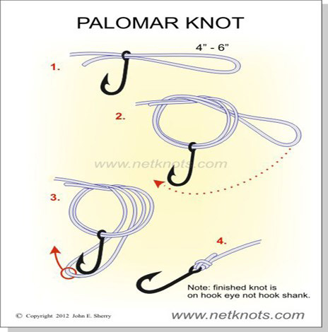
Palomar Knot
Simple knot for attaching a line to a hook, or a fly to a leader
Regarded as one of the strongest and most reliable fishing knots.
Recommended for use with braided lines
https://www.animatedknots.com/palomar/index.php

