Slide 1
Illegal Drugs

Slide 2
Health Risks of Drug Use
Substance abuse – any unnecessary or improper use of chemical substances for non-medical purposes
Includes
the use of illegal substances
The misuse of legal substances
Illegal drugs – chemical substances that may not be lawfully manufactured, possessed, or sold
Illicit drug use – crime of using, selling, or buying illegal drugs
Drugs are especially damaging to a teenage brain that is still developing

Slide 3
Factors influencing teen drug use
Peer pressure
Family members
Role models
Media messages
Perceptions of drug behavior
Misleading information
How do you feel the media messages differ between drug abuse and alcohol abuse?

Slide 4
Effects of drug use on health
Physical health
Illegal drugs are not monitored for quality, purity, or strength
Overdose – severe and sometimes fatal reaction to taking a large amount of a drug
Increased risk of contracting HIV and hepatitis
Mental health
Impairs ability to reason and think
Drugs alter brain structure and function
Social health
Damages relationships with friends and family
Drug use is leading cause of crime, suicide and unintentional injuries

Slide 5
Other effects of drug use
Tolerance
Body becomes accustom to the drug and needs larger amounts to feel the same effect
Psychological dependence
User believes they need the drug to function or feel good
Physiological dependence
Body develops a chemical need for drug and will suffer from withdrawal when the drug wears off
Addiction
Physiological and psychological dependence on a drug

Slide 6
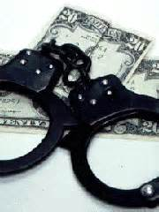
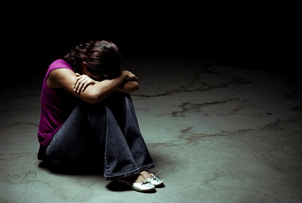
Consequences for individual user
Distracts you from pursuing goals
Lowers inhibitions increasing the chance that the teen will engage in risky behaviors
Depression and suicide
Legal consequences – jail time, fines

Slide 7
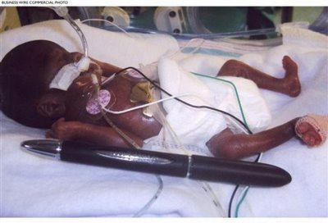
Consequences for friends and family
User may become withdrawn from friends and family
Emotional burdens
Financial burdens
Increased chance of birth defects to baby’s of mothers who used drugs during pregnancy

Slide 8
Consequences of drug use to society
Increases crime and violence
Costly to the US economy
Lost work hours and productivity
Health care costs
Legal fees
Law enforcement costs
Insurance costs

Slide 9
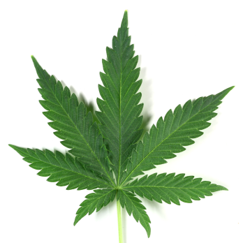
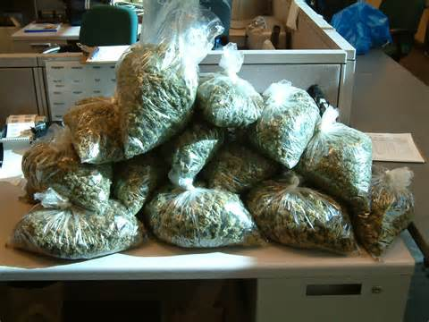
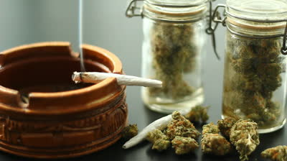
Marijuana
Plant that is smoked for it’s intoxicating effect
Sometimes mixed with food and eaten
One of the most widely used illegal drug
Nicknames:
Grass, weed, pot
Gateway drug – a drug that leads the user to try more dangerous drugs

Slide 10
Effects of Marijuana on the body
High – intense feeling of well-being followed by a crash
Increases risks of cancer from smoking
Weakened immune system
Hallucinations and paranoia
Impaired short-term memory
Impaired reaction time
Impaired concentration
Impaired coordination
Increase appetite
Increased risk of birth defects or still birth
Risk of infertility in females
Lowered sperm count and testosterone levels in males

Slide 11
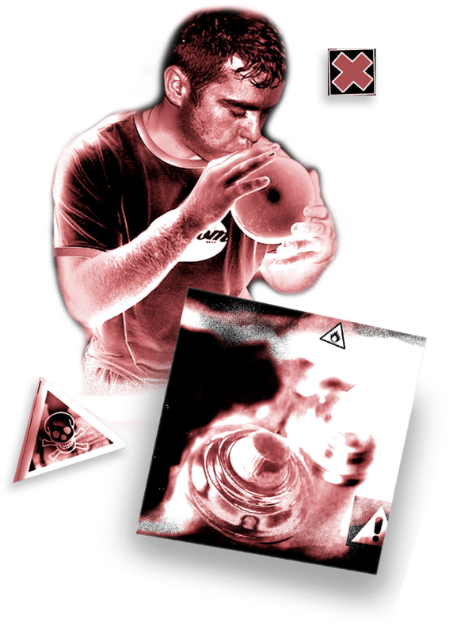
Inhalants
Substances whose fumes are sniffed or inhaled to get an effect
Include: solvents, glues, aerosols, paint, varnishes, gasoline
Causes a glassy stare, slurred speech, impaired judgment, nausea, coughing, nosebleeds, fatigue, and lack of coordination
Can cause permanent brain, liver and kidney damage, paralysis, cardiac arrest
Can be fatal

Slide 12
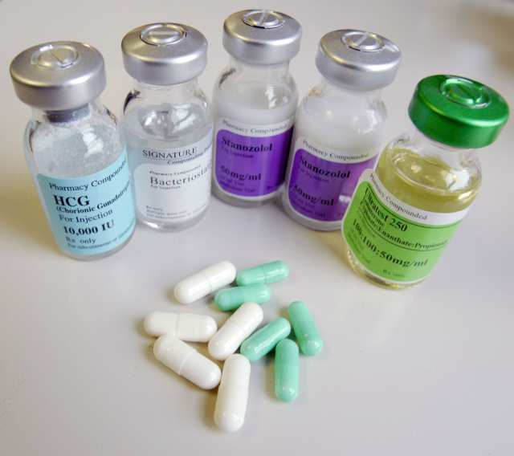
Anabolic steroids
Synthetic substances similar to male sex hormones
Sometimes prescribed for medical reasons
Non-medical use is illegal
Using results in:
Unnatural muscle growth and increased muscular strength when combined with physical conditioning
Weight gain
Acne
High blood pressure
Liver and kidney tumors
Mood swings
Violent behaviors
Paranoia
depression

Slide 13
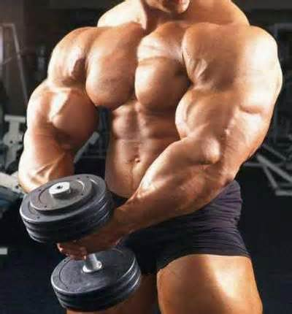
Steroid effects on males
Shrinking testicles
Reduced sperm count
Baldness
Development of breasts
Increased risk of prostate cancer

Slide 14
Steroid effects on females
Facial hair
Baldness
Changes in menstrual cycle
Deepened voice

Slide 15
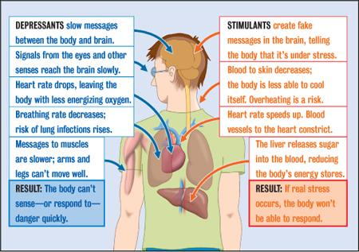
Psychoactive Drugs
Chemicals that affect the central nervous system and alter the activity of the brain
4 groups
Stimulants – speeds up CNS
Depressants – slows down CNS
Opiates – narcotics, derived from opium plant, prescription pain medicine
Hallucinogens – alters mood, thoughts, sense perception

Slide 16
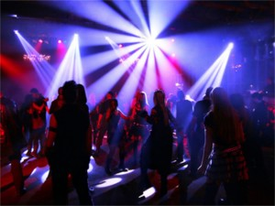
Club Drugs
Found at concerts, dance clubs, and drug parties
Can be slipped into food or drink without a person’s knowledge
Most are designer drugs – synthetic drugs that imitate the effects of other drugs
Examples:
Ecstasy (MDMA), Rohypnol, Meth

Slide 17
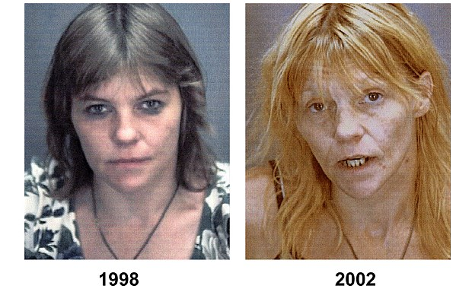
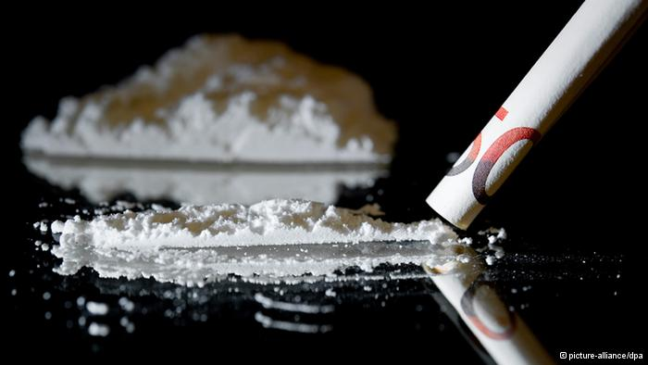
Stimulants
Methamphetamine
Cocaine
Crack
All three of these drugs are highly addictive

Slide 19
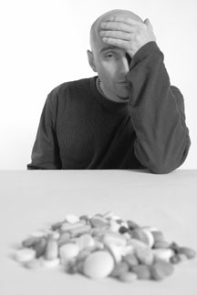
Depressants
Barbituates
GHB
Rohypnol (roofies)
Tranquilizers

Slide 20
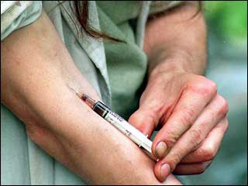
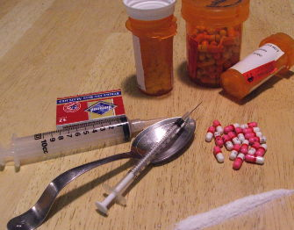
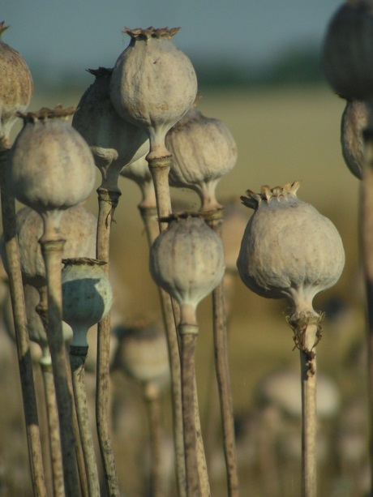
Opiates
Codein
Heroin
Morphine
Opium
Oxycodone (oxycontin)
Opiates are highly addictive

Slide 21
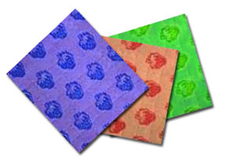
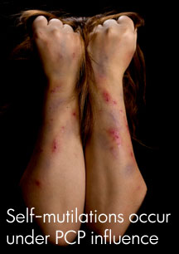
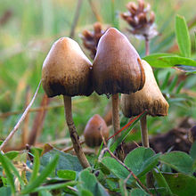
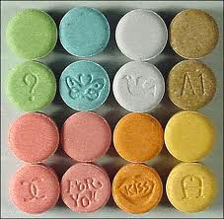
Hallucinogens
Ecstasy
LSD
Ketamine
PCP
Psilocybin (mushrooms)

Slide 22
Living Drug-free
Choose friends who share the same attitude about drug use
Participate in healthy alternatives to drug use like hobbies, sports, community organizations, school organizations

Slide 23
Drug Prevention
Drug-free school zones – penalties are more severe for violations
Zero tolerance policies
Drug dog visits
Community efforts – neighborhood watch programs to patrol, monitor and report illegal drug activity

Slide 24
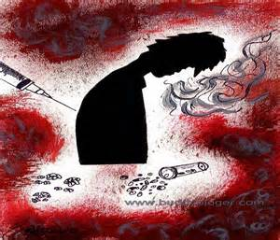
Signs of an addict
Lies about drug use
Withdraws from activities that were once considered important
Rapid weight loss
Change in eating and sleeping patterns
Takes unnecessary risks
Gets in trouble with authorities
Has red rimmed eyes or runny nose not associated with illness
Experiences blackouts
Has difficulty concentrating

Slide 25
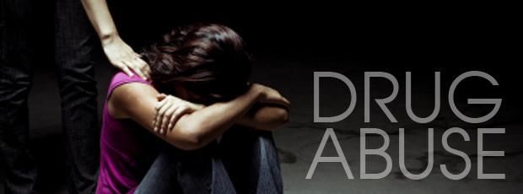
Drug Treatments
Rehabilitation – process of medical and psychological treatment for addictions
Addicts usually need the help of family and friends to get into treatment
Treatments can range from outpatient and short-term to long-term residential facilities
Support groups can be found in the community to assist recovering addicts

