Slide 1
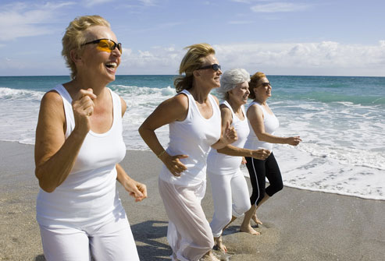
Lifetime fitness
Part 1 Chapter 1

Slide 2
Physical Activity, Exercise, and health
Physical activity – any movement that works the larger muscles of the body (arms, legs, back)
  Recreational
  Work related
Exercise – physical activity that is planned, structured, repetitive, and results in improvements in fitness
Physically active people live longer, healthier lives.

Slide 3
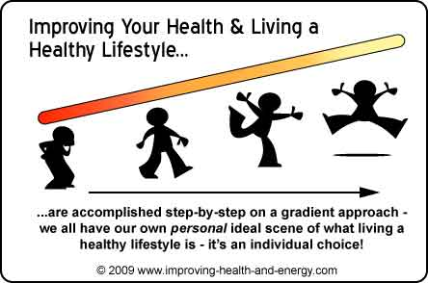
What is physical fitness?
Body’s ability to carry out daily tasks and still have enough reserve energy to respond to unexpected demands
Participating in a variety of activities and exercise can make staying fit enjoyable

Slide 4
Achieving total Personal Fitness
Participate in regular physical activity
Maintain acceptable levels of fitness
Eat nutritious foods
Sleep 8-9 hours per night
Get regular medical checkups
Maintain an appropriate weight
Avoid harmful substances like tobacco, alcohol and drugs
Physical fitness is just 1 component of personal fitness

Slide 5
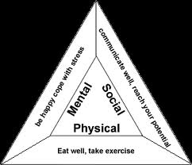
Fitness and the health triangle
Health – combination of physical, mental/emotional, and social well-being
Wellness – total health in all 3 areas
Physical fitness is essential to maintaining your overall health
Health triangle includes the 3 areas

Slide 6
Physical health
Enhanced when a person is physically fit
  Higher energy level
  Improved strength, flexibility and muscle tone
  Better heart and lung function
  Stronger bones
  Healthy weight and reduced body fat
  Improved coordination
  Better sleep

Slide 7
Functional health – ability to maintain high levels of health and wellness by reducing risks for developing health problems
Physical activity helps to maintain functional health because it helps eliminates risks linked to sedentary lifestyles like:
  Heart disease
  High blood pressure
  Stroke
  Diabetes
  Some forms of cancer

Slide 8
Mental / emotional Health
Is improved when people are physically fit
Physically fit people:
  Think more clearly
  Better able to concentrate on work or school
  Experience higher self-esteem

Slide 9

Social Health
Is improved with better personal fitness
Better able to
  Develop and maintain friendships
  Work well as part of a group
  Effectively resolve conflicts

Slide 10
Functional Fitness
Physical ability to function independently in life, without assistance
These people usually maintain high levels of health and wellness
Physical Activity pyramid – shows recommended physical activity patterns for life

Slide 11
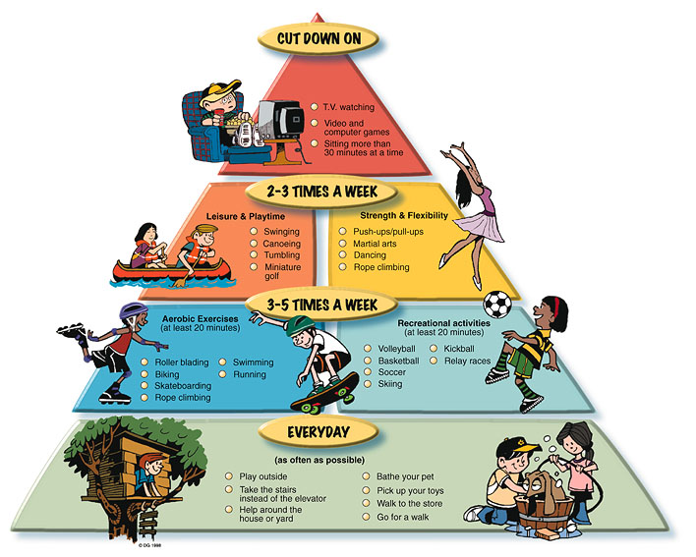
Physical Activity pyramid

Slide 12

Healthy people 2010
Government sponsored plan to encourage people to make health and fitness a top priority
Goal to be accomplished by 2010 – all Americans to reach and sustain high levels of either skill related fitness or health related fitness or both

Slide 13
Personal Fitness and risk factors
Current life expectancy is 77
Risk factors – conditions or behaviors that are a potential threat to your well-being
Factors that put you at risk for certain diseases
See pg 13
These factors make it difficult to maintain a high level of functional health and fitness

Slide 14
Risk Factors you can’t modify
Factors that are out of your control
Your behaviors can minimize the impact of these
Age – chances for developing diseases go up as we age
Heredity – traits passed onto you from your parents that determine your personal fitness potential
  Your genetic make-up can make you pre-disposed to certain diseases and conditions
  Gender – differences in males and females and their personal fitness

Slide 15
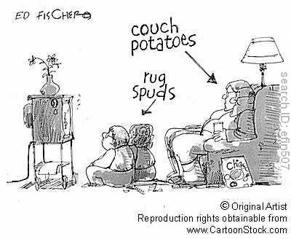
Changeable risk factors
Physical activity
  Sedentary adults develop chronic diseases at a much higher rate
Eating habits
  Being overweight or obese increases you chance for heart disease and diabetes
Tobacco use
  Increases risk of heart and lung disease, cancer
Stress management

Slide 16
Developing a positive fitness attitude
One third of all teens lead a sedentary lifestyle
0ne third of all teens are overweight
Attitudes are influenced by peers and media
Common negative attitudes toward physical activity
  Exercise is boring
  I’ll start watching what I eat when I am adult
  I’m too busy to exercise
  Physical activity is strictly for “athletes”
  I’m too tired to exercise

Slide 17
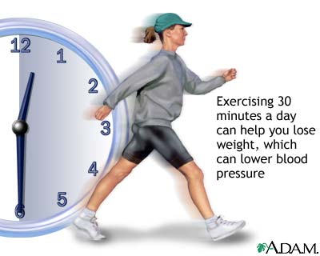
Benefits of Personal Fitness
Better self-esteem
Better performance in school and sports
Increased life expectancy
Higher level of functional health and fitness

Slide 18
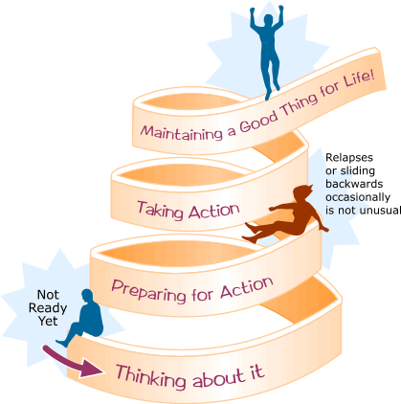
Getting Started
Set fitness goals
Make a schedule of fitness activities
Be patient: progress slowly
Enjoy it – make it a social outing
Behavioral change stairway – Which step are you on?
  Not thinking about being fit
  Thinking about being fit
  Planning on becoming fit
  Starting to become fit
  Maintaining fitness behaviors
  Relapse or stopping fitness behaviors

Slide 19
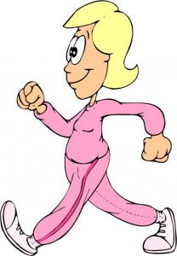
Exercise Guidelines
Regular exercise – done most days of the week, preferably daily
Moderate exercise – ranges in intensity from light to borderline heavy exertion
Vigorous exercise – ranges in intensity from heavy to maximum exertion
Shoot for 5 days of regular exercise plus some moderate exercise or 3 days or RE plus some vigorous exercise
225 minutes per week

Slide 20
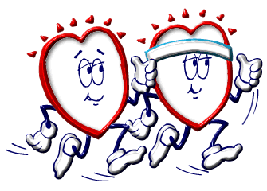
Lifetime fitness part 2
Exercise Principles Ch. 3

Slide 21
Exercise Principles
Overload principle – in order to improve your level of fitness, you must increase the amount of regular activity or exercise that you normally do
Specificity principle – overloading a particular component will lead to fitness improvements in that component alone
Progression principle – as your fitness levels increase, so do the factors in your FITT program

Slide 22
The Fitt Principle for exercise
Describes components of an exercise program
Frequency – how often you exercise
  60 minutes of aerobic activity per day or at least 225 per week
Intensity – how hard you work
Time – length of time that you work
Type – the specific type of activity

Slide 23
Frequency
Increasing frequency can be a way to apply the principle of overload
Depends on fitness level
Beginners should shoot for 3-5 days per week of cardiovascular exercise and 2-3 days of weight training
Exercise that is infrequent results in limited improvements but exercising too often can lead to overuse injuries

Slide 24
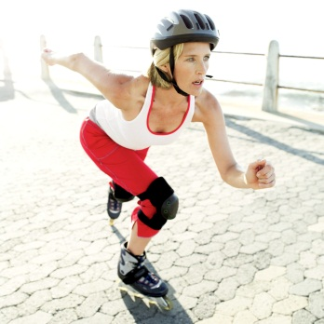
Intensity
The exertion level of your exercise
Another way to apply the principle of overload is by increasing your intensity
When intensity is too low, progress is limited
Can be measured in 3 ways:
  Maximum Heart Rate
  Perceived exertion
  Talk test
Maximum Heart Rate - you can measure your exertion level by your heart rate, applies to cardiovascular conditioning
  Maximum heart rate – 220 minus your age
  Beginning intensity of exercise should be 60 -70% of MHR
  Average to high levels of fitness should shoot for 70 – 90%

Slide 25
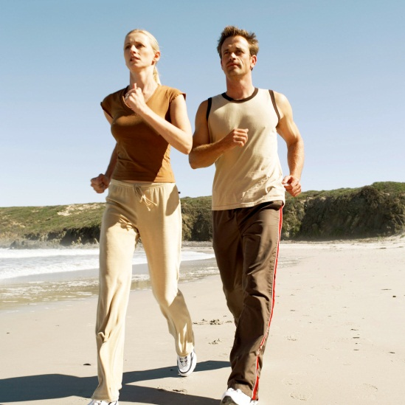
Perceived exertion – how hard you feel you are working during exercise, numerical scale (6-20) based on cues
  Cues: how hard you are breathing
  Your heart rate
  Muscle or skeletal discomfort
Talk test – measure of your ability to carry on a conversation while exercising
  Talking with slight effort = light to vigorous

Slide 26
Time
Duration of a single workout in minutes or hours
Another way to overload is by increasing time
Beginners start at 20-30 minutes and then progress to longer sessions

Slide 27
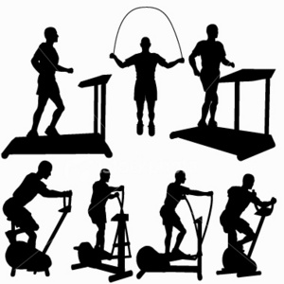
type
The particular type of exercise
Based on your fitness goals
Also guided by:
  What you enjoy
  How much time you have
  How much money you have to spend on equipment

Slide 28
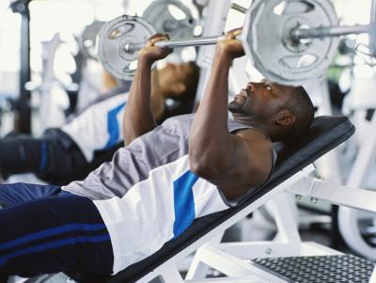
Principle of specificity
overloading a particular component will lead to fitness improvements in that component alone
Examples:
  Cardiovascular conditioning will improve the heart muscle
  Sit-ups will improve muscular strength and endurance for abdominal muscles

Slide 29
Principle of progression
As fitness levels increase, so do the factors in FITT
Never increase all factors at once
3 stages:
  Initial stage
  Improvement stage
  Maintenance stage
Rate of progression effected by:
  Initial fitness level (lower levels have quicker improvement)
  Heredity
  Rate of overload
  Specific goals

Slide 30
trainability
The rate at which an individual’s fitness levels increase during fitness training
Heavily dependent on heredity
Training plateau – time during training when little to no fitness improvement occurs
Detraining – loss of functional fitness when people quit fitness conditioning
Cross training – varying exercise or activity routine or type
  Helps to avoid detraining or fitness plateau

Slide 31
Components of a complete workout
Warm-up – consists of a variety of low-intensity activities that prepare the body to workout
  Gradually raises heart rate and body temp
  Minimizes injuries and soreness
  Active – actively works body
  Passive – raises body temp from outside sources like a hot bath

Slide 32


Workout – period of time engaged in exercise
Should be tailored to your specific fitness level and goals
Based on the exercise principles

Slide 33
Cool down – lowers the heart rate gradually
Prevents pooling of blood in the lower body which can cause dizziness and feeling faint
2 phases:
  Cardiovascular cooldown – slow continual movement after exercise for 3-5 minutes
  Stretching cooldown – static stretching that minimizes stiffness and muscle soreness

