Slide 1

Mental Health
Standards:
HE.HS.7

Slide 2

What is health?
The combination of physical, mental, and social well-being
Must pay attention to all three areas to maintain healthy balance

Slide 3
What is mental / emotional health?
The ability to accept yourself and others, express and manage emotions, and deal with the demands and challenges you meet in your life

Slide 4
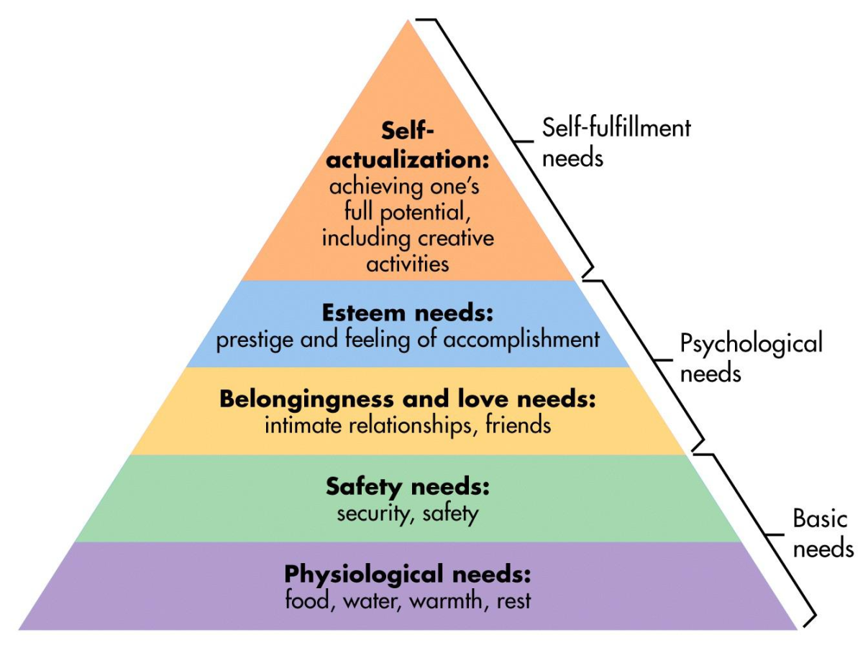
Maslow’s Heirarchey of Needs
Needs of lower levels must be filled before upper levels

Slide 5
Characteristics of Good Mental and Emotional Health
Sense of belonging – closeness to others who support you – family, friends
Sense of purpose – recognizing your value and importance
Positive outlook – seeing the bright side of life
Self sufficiency – being confident enough to make decisions that promote your independence and self-assurance
Healthy self-esteem – helps you accept and recover from difficulties and failures

Slide 6
How does self-esteem develop and improve?
Developed over time when you are praised for mastering a task and reassured on tasks yet to be mastered
Improved by
  Choosing friends who value and respect you
  Focus of positive aspects of self
  Replace negative self-talk with positve
  Consider mistakes as learning opportunities
  Exercise regularly to feel more energized
  Accept things you can’t change and focus on those you can
  Try new activities

Slide 7
What is stress?
The reaction of the mind and body to everyday challenges and demands
What are some examples of stress?
  Taking a test
  Being late to catch the bus
  Performing well in the big football game
Often times stress is unavoidable. How it effects you, depends on your perception of or reaction to the stress
  IE – you view a disagreement with a friend as ruining the relationship where the friend may believe that you will work through the issue

Slide 8
Is stress always bad?
No, it can have positive effects as well as negative
Positive stress-(Eustress) can motivate you to work harder at something
Negative stress can harm your health and interfere with your ability to carry out daily activities
  Can cause feelings of: anger, frustration, distraction, being overwhelmed

Slide 9
What are causes of stress?
Stressor – anything that causes stress
  Can be real or imagined, expected or unexpected
  Can be different for individuals based on your experience and perceptions
  What are some examples of stressors common to everyone and those that may vary from person to person?

Slide 10
How does the body respond to stress?
Example: You walk by a house and a large dog runs rapidly to the fence barking and growling at you. What is your body’s response?
Startled feeling, increased heart rate, rapid breathing
Automatic physical response of the body
  Alarm – mind and body go on alert to defend itself or flee from the stress…. “fight or flight”
  Resistance – body adapts and reacts to stressor allowing you to continue to perform for brief period
  Fatigue – after prolonged exposure to stress, the body loses the ability to adapt and you become tired and unable to manage other stresses effectively

Slide 11
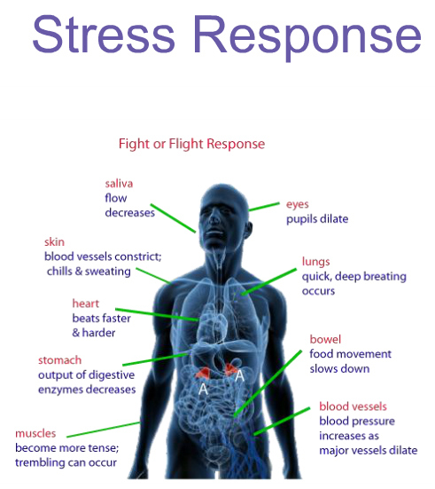
The alarm stage of response
Step 1: Hypothalamus at base of brain receives danger signals from other parts of brain – releases a hormone that acts on the pituitary gland
Step 2: Pituitary gland secretes hormone that acts on the adrenal glands
Step 3: Adrenal gland secrete adrenaline to prepare body for fight or flight causing these physical symptoms:
  Dilated pupils, increses perspiration, increased pulse and HR, rise in blood pressure, increase blood flow to muscles and brain, increase in muscle tension

Slide 12
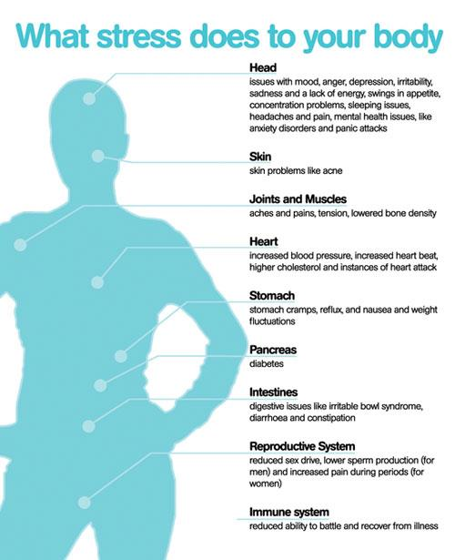
How is health effected from prolonged exposure to stress?
Psychosomatic response – physical reaction of body that is cause by stress rather than injury or illness
  Headache
  Weakened immune system
  High blood pressure
  Digestive disorders
  Grinding of teeth

Slide 13
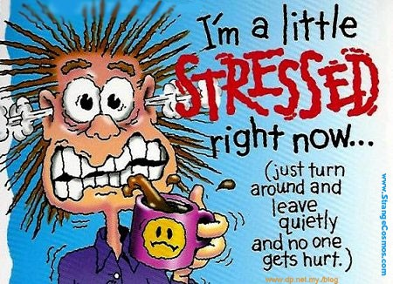
How can I manage stress?
Effects of stress build up over time
Chronic stress – stress associated with long term problems that are beyond a persons control
If the stress is not properly managed, it can take a toll on your physical and mental health

Slide 14
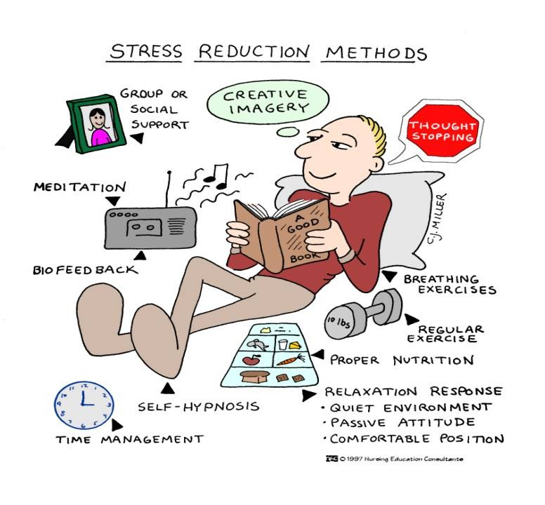
Management techniques
Avoidance or limiting – stay away from or limit your exposure to stressors
Relaxation techniques – deep breathing, pleasant thoughts, stretching, warm baths, massage
Redirect your energy – into exercise, art projects, recreation activities
Seek support – talk about you stress with someone you trust
Maintain good physical health

Slide 15
Defense Mechanisms
Mental processes that protect individuals from strong or stressful emotions or situations
Repression-involuntarily pushing unpleasant feelings out of conscious thought.
Rationalization-making excuses to explain a situation or behavior.
Denial-unconscious lack of acknowledgement of something that is obvious to others.
Compensation-making up for weaknesses and mistakes through gift giving or extreme efforts.
Projection-attributing your own feelings or faults to another person or group

Slide 16
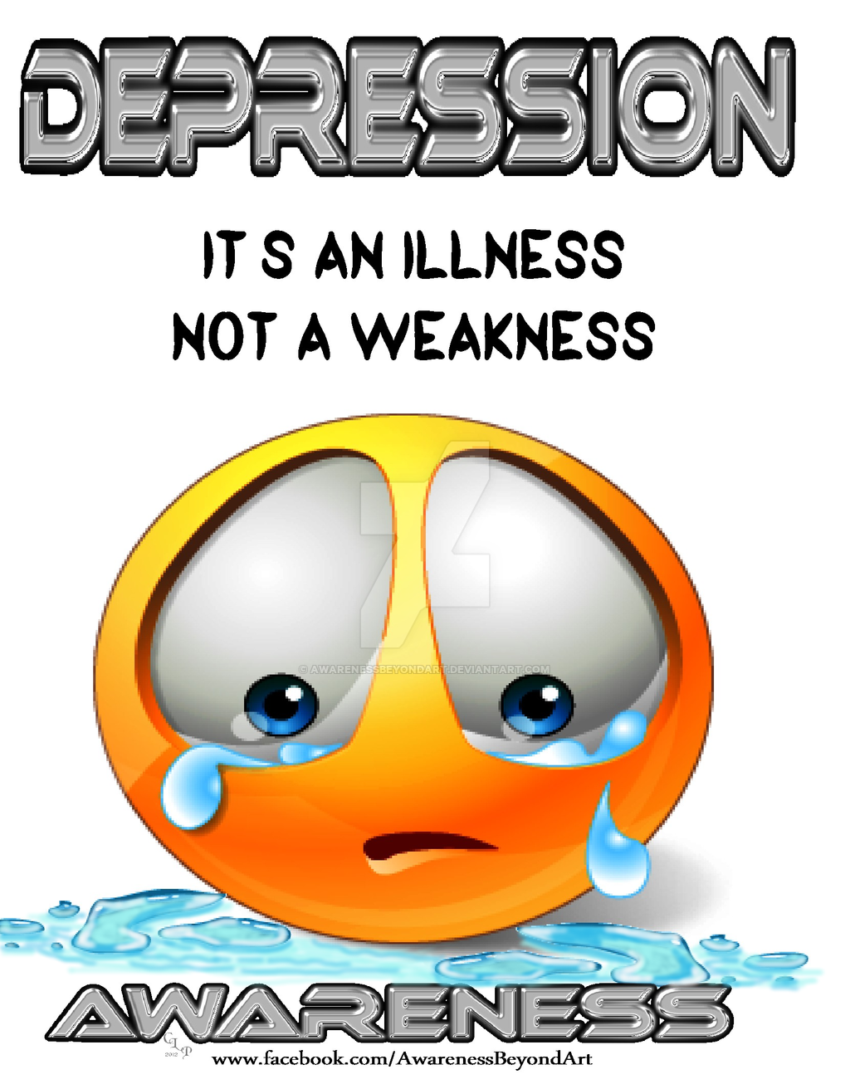
Anxiety and Depression
Anxiety – feeling uneasy or worried about what may happen
  Occurs occasionally
  Normal response to life events
Depression – prolonged feeling of helplessness, hopelessness and sadness
  Sometimes requires medical help
  Can be caused by physical, psychological and social reasons
  Treatable illness

Slide 17

Mental Disorders
effect over 57 million Americans (1 in every 4)
Illness of the mind that can affect thoughts, feelings, and behaviors of a person, preventing him from leading a happy, healthful, and productive life
Medical conditions that require diagnosis and treatment
Many are reluctant to seek treatment due to the stigma associated with mental dis.
Types of disorders: anxiety, impulse control, eating, mood, conduct, schizophrenia, personality

Slide 18
Suicide
Sometimes stress can cause alienation (feeling of isolation)
Inhibits a person’s ability to cope with life’s difficulties
Some may seek an escape from the pain by committing suicide
3rd leading cause of death for teens aged 15-19
3 common risk factors
  Depression or other mental disorder
  Substance abuse
  Exposure to other teens who have died by suicide (cluster suicides)

Slide 19
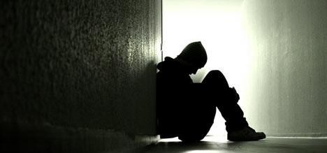
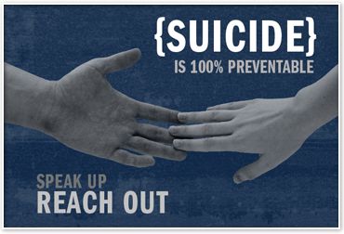
Warning signs
Statements about wanting to be dead
Giving away belongings
Withdrawal from friends
Intolerance for praise
Substance abuse
Obsession with death
Impulsive behavior

Slide 20
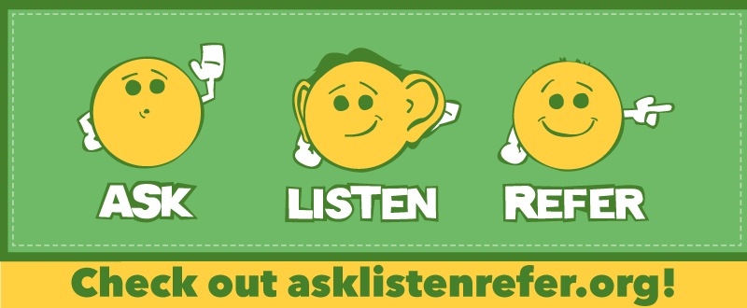
How you can Help
Show empathy
Initiate a meaningful conversation
Show support
Ask questions
Persuade the person to seek help

Slide 21

Mental Health Professionals
Counselor
School psychologist
Psychiatrist
Neurologist
Clinical psychologist
Psychiatric social worker

Slide 22
Task – on notebook paper
List 5 positive things about yourself
Create a management plan for a particular stressor. Follow the format below:
  1. Describe the stressor
  2. List 3 methods you could use to manage the stress

