Slide 1
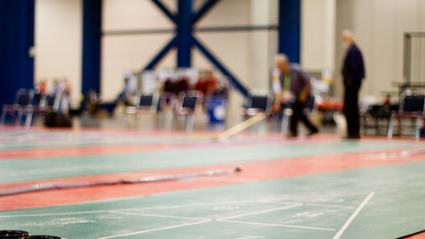
SHUFFLEBOARD
This Photo by Unknown Author is licensed under CC BY-SA

Slide 2
OBJECTIVE
The game of shuffleboard is played by: two (2) persons (called singles), or by four (4) persons (called doubles).
The object of the game is to propel discs by means of a cue on to a scoring diagram at the opposite end of the court--to score, to prevent opponent from scoring, or both.

Slide 3
HISTORY
The game was first called shoveboard and later shovelboard. It seems to have originated in England, where there is a record of its being played in 1532, and in its earliest form consisted of shoving coins across a polished tabletop (shovelpenny) as a past time for royalty. The game would become so popular with the masses that people stopped going to work, causing it to be banned.
Shuffleboard first came to the United States around the time of the Civil War and grew during the late 1800s and early 1900s. In modern times, a modified form of the old indoor game became popular among travelers on ocean liners and cruise ships as a deck game. For the shipboard version, called shuffleboard, courts of various designs were marked on the deck, with lined sections at either end.

Slide 4
HISTORY
Shuffleboard was introduced about 1913 at Daytona Beach, Florida, as a game on land. The game was so popular that it spread rapidly through the United States, particularly in retirement communities, with each community devising its own rules of play. The modern form of shuffleboard was defined at St. Petersburg, Florida, in 1924.

Slide 5
RULES & REGULATIONS
To start a game, the yellow (light-colored) disc is shot first. Play alternates yellow (light) then black until all discs are shot. Yellow (light) shall always be played from right side of the head of court, and left side of foot of court.
Players shall not stand in the way of, or have a cue in the way of, or interfere with any other players at any time.
Any player shooting two (2) consecutive discs, PENALTY: 10-Off, plus any 10-Offs the offender may have on the court.

Slide 6
RULES & REGULATIONS
Any disc that clearly leaves the court beyond the farthest baseline or goes off the sides of the court is a dead disc.
A disc which stops less than eight (8) inches beyond the farthest baseline shall be removed.
A disc that is leaning over the edge of the court and touching the alley shall be immediately removed.

Slide 7
SCORING
The scoring diagram consists of one 10-point area, two 8-point areas, two 7-point areas and one 10-Off area. After both players have shot their four (4) discs, score all the discs on the diagram within and not touching the lines. The separation triangle in the 10-Off area is not considered.
Play continues until all discs have been shot in that half-round, even if the game has been reached. If a tie game results at the game point or over, play is continued in regular rotation of play, until two full rounds in Doubles or one full round in Singles is completed. At that time the side with the higher score wins, even if it has less than the number of points specified as game point. If the score is tied again, play continues again as outlined.

Slide 8
SCORING
Games may be played to 50,75, or 100 points, as players desire. To count, disk must be entirely within scoring sections, clearing all lines.
In match play (best 2 out of 3), the second game is started with a black disc.

Slide 9
EQUIPMENT
Four (4) discs shall be colored yellow, four (4) colored black. These eight (8) discs comprise a set. Other colored combinations may be used, such as white, red, blue, etc., as long as there are two (2) contrasting colors.
The cue shall not have an overall length of more than six feet 3 inches (6’3”).

Slide 10
TERMINOLOGY
Cue – Also called a shuffleboard stick, this is a device used to shoot the discs in outdoor/floor shuffleboard.
Discs – These are the playing pieces you use in outdoor shuffleboard in place of pucks.
Head – A head in outdoor shuffleboard is slang for the end of the court that has the scoreboard. This is the side of the court from where all games should start
Hammer – A hammer shot is the last shot of the round.

Slide 11
References
Allen R. Shuffleboard Company. (2018). Shuffleboard Associations. Retrieved from https://http://www.shuffleboard-1.com/ShuffleboardAssociations/tabid/64/Default.aspx
Florida Shuffleboard Association. (2019). Rules. Retrieved from https://http://www.fsa-shuffleboard.org/
USA National Shuffleboard Association. (2019). Official USA NSA Rules. Retrieved from https://https://usansa.weebly.com/official-usa-nsa-rules.html

