Slide 1
Team Building and Leadership
Hillgrove High School

Slide 2
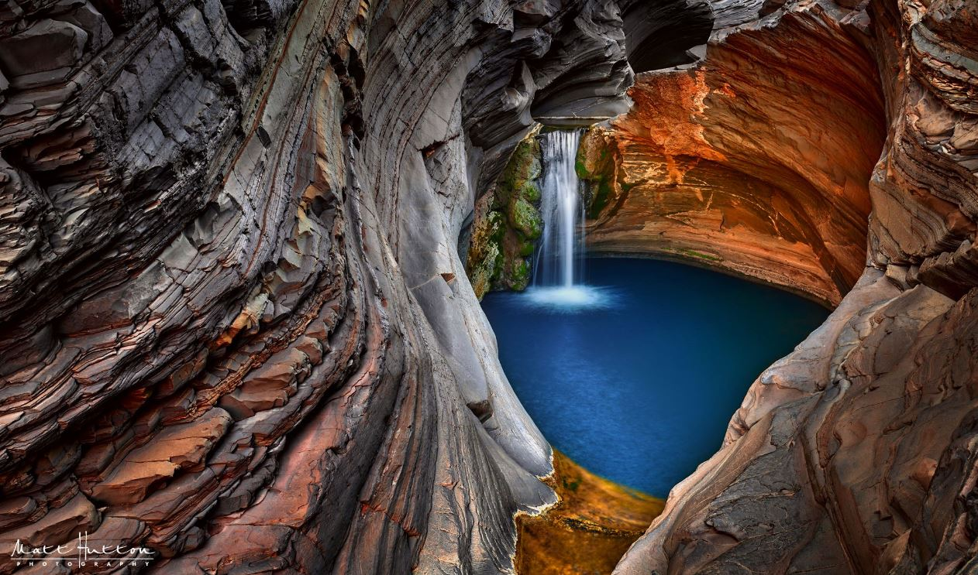
Human Needs in the Outdoors
Physiological
Emotional
Social
Security
Spiritual

Slide 3
Physiological Needs
Includes regulating heat, cold, hydration, food, and energy levels.

Slide 4
Emotional Needs
Feeling comfortable enough to put forth ideas in a group without being bullied or made fun of.
Establish healthy community standards like our class rules: Always be:
SAFE
RESPECTFUL
RESPONSIBLE

Slide 5
Social Needs
Human Beings are social animals.
Opportunities for casual social interaction are key to healthy group formation.

Slide 6
Security Needs
Physical safety is every group members responsibility.
What one person does affects the whole group.

Slide 7
Spiritual Needs
Spirituality has different meanings for different people.
It is important to try to address this need for everyone.

Slide 8
What is leadership?
The ability to assess people and situations and then decide on the best course of action in order to achieve a specific goal
-An ongoing process
-an action
-an interaction between one person and a group of people gathered around a specific feature.

Slide 9
Traits of a good leader
Communicate effectively
Problem solver
Can disagree with others in a healthy manner
Decision maker on best approach to achieve common goal.
Leadership style is dependent on:
-Personality
-Beliefs
-Skill sets

Slide 10
Leadership Styles
Autocratic-authoritative, domineering, doesn’t invite feedback or listen to others’ ideas.
Democratic-leader always consults with group, everyone is included in decision making, majority rules.
Laissez-faire- hands off style, gives little or no direction, group members have maximum freedom, group determines goals and actions.

Slide 11
Followership
All group include leaders and followers.
Followers are necessary for a healthy group.
Different situations will determine who the leader is and who is the follower based on individual skill sets.
Roles may change from one situation to the next.

Slide 12
Team Building Etiquette
Be respectful of others, self, and property
no name calling
-give everyone a chance to speak
Provide support for other group members
Contribute to the goal of the group
Do your part to keep the group safe

Slide 13
Stages of Group Development
Forming- high dependence on the leader, members are figuring out what their role is in the group while being polite and courteous.
Storming- members are comfortable enough to move past pleasantries, normal for fights and disagreements to occur in this stage, conflict is necessary for growth. Once groups successfully exit this stage, they will become closer and stronger.
Norming- Behavior is adjusted to allow the group to accomplish tasks-rules and values are agreed upon, roles begin to be established for members.
Performing- members are functioning effectively as a unit. Members are comfortable with others’ strengths and weaknesses. Disagreements resolved in healthy manner.

